Slide 2
Banchory Group Practice
Community event: ‘Looking after the kids’
Dr Gill Archbold & Dr Claire Walker

Slide 3
Topics for tonight
Sepsis/serious infection/meningitis
Head injury/concussion
Anaphylaxis
Croup/Breathing difficulties
Bleeding/poisoning/burns
Choking/Basic life support

Slide 4
Sepsis
Also known as ‘blood poisoning’
Rare but serious complication of infection where the body attacks its own organs and tissues
Triggered by infection in any part of the body: bacterial infection most common
Urine/chest/brain/appendix

Slide 5
Sepsis
Everyone is potentially at risk
More vulnerable groups of children
Very young
Long term health problem eg diabetes
Low immune system due to illness or chemotherapy
Recent surgery

Slide 6
Sepsis - features
Will seem more unwell than you expect for normal childhood illness
Child very lethargic or difficult to wake
Skin looks mottled, bluish or pale
Feels abnormally cold to touch
Breathing is very fast
Has a rash that does not fade when you press it
Has a fit or convulsion

Slide 7
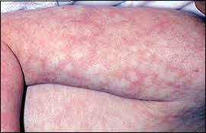
Mottling

Slide 8
Sepsis rash

Slide 9
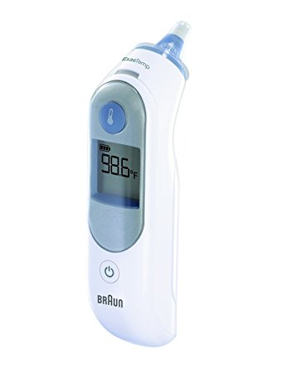
Sepsis - symptoms
Temperature: (normal = 36 – 37.4 C)
!!Over 38C in babies under three months!!
!Over 39C in babies aged three to six months !
High temperature in a child who cannot be encouraged to show interest in anything
Low temperature (below 36C – check three times in a 10-minute period)

Slide 10
Sepsis - symptoms
Breathing looks like hard work
Babies
"grunting" noises with every breath
Breathing that obviously pauses
Children
Can’t say more than a few words at once

Slide 11
Sepsis - symptoms
Toilet/nappies
not had a wee or wet nappy for 12 hours
Eating and drinking
new baby under one month old with no interest in feeding
not drinking for more than eight hours (during the day)
bile-stained (green), bloody or black vomit/sick

Slide 12
Sepsis – symptoms
General features
child cannot be encouraged to show interest in anything
baby is floppy or child is very weak
continuous tired crying in a younger child
older child who's confused
not responding or very irritable

Slide 13
Sepsis – what to do
If your child has symptoms – seek urgent attention from GP or 111 – ask ‘could this be sepsis’
If child has severe symptoms – dial 999 or go directly to A&E
Child will be examined and if sepsis suspected will usually be sent to hospital for investigation and started on antibiotics

Slide 14
Treatment for sepsis
If recognised early and not severe may be treated at home with antibiotics
If more severe will require hospital investigation and treatment with oxygen/fluids as well as antibiotics.
Most will make a full recovery

Slide 15
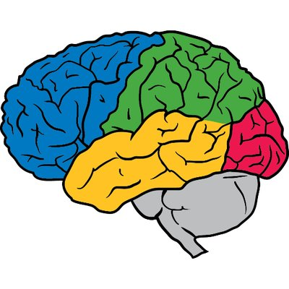
Meningitis
Meningitis - infection of the protective membranes that surround the brain and spinal cord.
Symptoms - develop suddenly and can include:
High fever >38
Headache, dislike of bright light, stiff neck
Vomiting
Blotchy rash that doesn't fade when a glass is rolled over it (this won't always develop)
Irritable
drowsiness or unresponsiveness
seizures (fits)

Slide 16
Meningitis – glass test

Slide 17
Meningitis -causes
Most commonly viral
Bacterial rarer but much more serious
Meningococcal bacteria – A,B,C, W,X,Y,Z
Pneumococcal, Hib
Infection usually spread by someone carrying bacteria but who is not ill themselves
Less commonly from someone who has meningitis

Slide 18
Meningitis - treatment
Treat as bacterial until cause established
Antibiotics, +/- fluids, oxygen
Hospital - Bloods, lumbar puncture, CT scan
Antibiotics for close contacts eg household
Not usually if only had brief contact
Public Health will advise

Slide 19
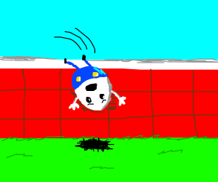
Head injury
Head knocks are common in children
Most are mild and do not cause any damage to the brain
Rarely a more severe injury can cause damage to the brain or a blood vessel near the brain to leak and put pressure on the brain

Slide 21
Head injury – higher risk
Consider spinal injury also
Fall from >1 metre or 5 stairs
Bike collision
Struck by a motor vehicle
High speed or roll over vehicle accident
Diving accident
Impact from golf club/cricket or baseball bat

Slide 22
Head injury – worrying features
Loss of consciousness
Vomiting x2 or more
Worsening headache despite paracetamol
Seizure
Problem - limbs/eyes/behaviour/memory
Possible skull fracture *
Alcohol/drugs involved

Slide 23
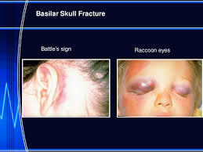
Signs of skull fracture
Bleeding from ear
Clear fluid from ear or nose
Major scalp wound

Slide 24
Symtoms to expect
A mild headache
Feeling a bit sick without being sick
Being slightly irritable and grumpy
Tiredness
Poor appetite
Some difficulty concentrating
These will usually resolve within 2 weeks
Should avoid contact sports for 3 weeks

Slide 25
https://sportscotland.org.uk/clubs/scottish-sports-concussion-guidance/

Slide 26
Anaphylaxis (ana-fill-ax-is)
Severe, potentially life-threatening allergic reaction.
Affects more than one body system eg skin, lungs, heart, gut, circulation.
Symptoms can start seconds or minutes after exposure to the food or substance that you are allergic to and usually progress rapidly.

Slide 27
Anaphylaxis - causes
Peanuts, other nuts, milk, eggs, shellfish, sesame seeds, kiwi fruit
Penicillin
Latex
Wasp or bee stings

Slide 28
Anaphylaxis - symptoms
Widespread flushing of the skin
Nettle rash = hives = urticaria
Swelling of the skin (known as angioedema) anywhere on the body
Swelling of the lips +/- tongue
Abdominal pain, nausea and vomiting
Can lead to weakness/collapse

Slide 29
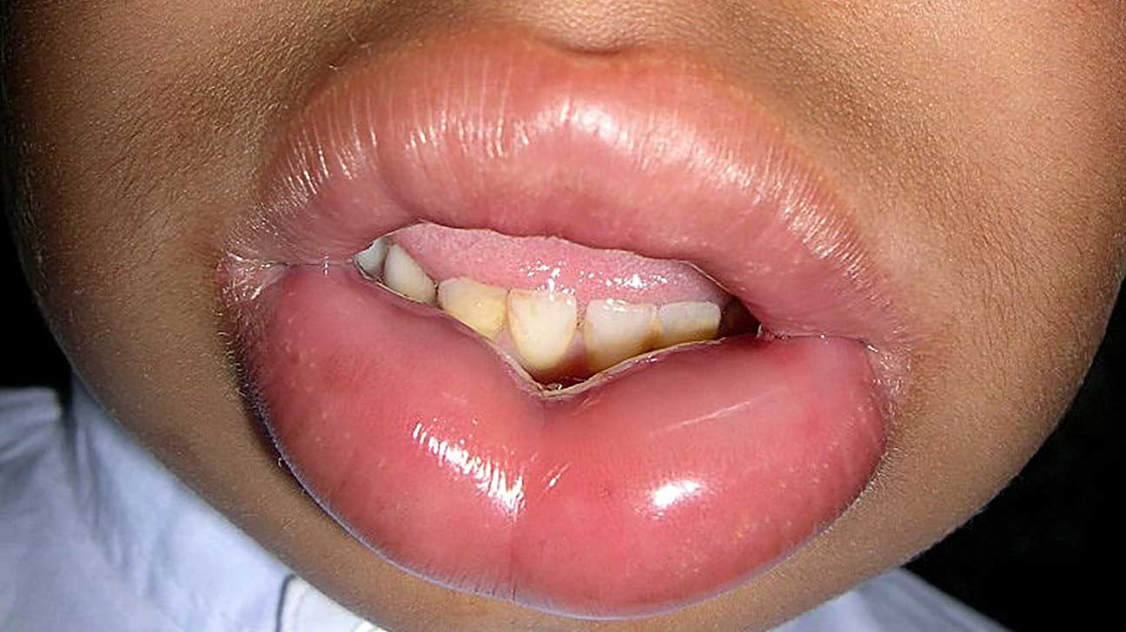
Lip swelling! Urticaria

Slide 30
Anaphylaxis - treatment
Dial 999
If conscious and breathing difficulty sit up – if becoming weak lie down and elevate legs
Give treatment if available – antihistamine/prednisalone (steroid)
May have epi pen (adrenaline)- give and repeat after 5 mins if no improvement

Slide 31
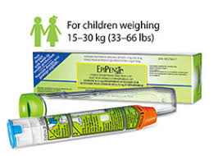

Slide 32
Croup
Childhood condition that affects the windpipe (trachea), the airways to the lungs (the bronchi) and the voice box (larynx)
Caused by virus eg parainfluenza, flu, RSV
Most commonly affects 6 months - 3 yr olds
Boys >girls
Can have croup more than once

Slide 33
Croup - symptoms
Often starts as normal viral cough cold
Fever
Distinctive barking cough develops – worse at night
a hoarse or croaky voice
In more severe cases difficulty breathing
a harsh grating sound when breathing in, called STRIDOR

Slide 34
Difficulty breathing
Breathing faster than usual
(? Able to feed/talk)
Nostrils flaring
Using other muscles to help
Skin around ribs and chest pulls in when they breathe making bones more visible
Stridor/wheeze/grunting
Blue tinged lips + tongue
Lethargic/drowsy

Slide 35
Clip of stridor
https://www.youtube.com/watch?v=oeoAze-CHng

Slide 36
Normal parameters
Heart rate Resps
Infants <1 year 110-160 40
Toddler 1-2 years 100-150 35
Pre-school 3-4 years 95-140 30
School 5-11 years 80-120 25
Adult 60-100 12-20

Slide 37
Croup - treatment
Often mild and self –limiting
Worst symptoms often last around 48hrs
Treat fever, sit up, reassure
If significantly increased work of breathing/stridor – oral steroid treatment
Very rarely, if severe may require oxygen/steroid/adrenaline
+ hospital admission

Slide 38
Bleeding – from a wound
Press firmly with cloth/towel
Elevate limb if possible
May need to press for up to 10 mins
Don’t tie anything round to stop circulation
If bleeding soaks through put another layer on top
If wound gaping, continues bleeding or something eg glass in wound will need minor injury unit/A&E

Slide 39
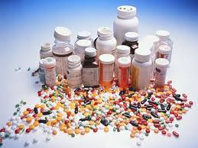
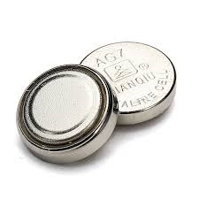
Poisoning
Key here is prevention where possible
Write down name and strength of substance
If child well – phone GP or 111 for advice
Don’t try and make them sick
If soreness/blistering in mouth – A&E
Button batteries dangerous

Slide 40
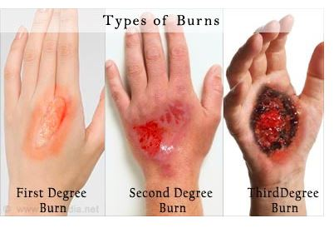
Burns

Slide 41
Burns
Cool under running water for up to 10 mins
Cover with something clean and not fluffy
Don’t remove clothing if stuck to skin
Don’t put any ointment on the burn
May require health centre/A&E depending on severity

Slide 42
Choking
Most episodes are witnessed
Sudden onset coughing/gagging/stridor
Coughing is safer and more effective than intervention
Encourage coughing if able to do so

Slide 43
Choking – Resuscitation Council (UK) 2015 Guidelines
Ineffective coughing | Effective cough
Unable to vocalise Quiet or silent cough Unable to breathe Blue tinge to lips/tongue Decreasing level of consciousness | Crying or verbal response to questions Loud cough Able to take a breath before coughing Fully responsive
General signs of choking
Witnessed episode Coughing or choking Sudden onset Recent history of playing with or eating small objects

Slide 44
Choking –Resuscitation Council(UK) 2015 Guidelines

Slide 45
Paediatric Basic Life Support

Slide 46
References
https://www.resus.org.uk/
https://www.nhsinform.scot/
https://sepsistrust.org/
https://sportscotland.org.uk/

Slide 47
Thank you…
Banchory Guides for the use of the facility
Sarah Chambers (Practice manager)
Dr Claire Walker GP Banchory

